Slide 1
Li-fi technology
CREATED BY
DEBAYAN DE
SUMITRA CHOUDHUTY
KAUSHIK BISWAS

Slide 2
WHAT IS Li-fI
LI-FI OR LIGHT FILDEALITY IS A BIDIRECTIONAL ,HIGH SPEED AND FULLY NETWORKED WIRELESS COMMUNICATION TECHNOLOGY SIMILAR TO WI-FI, WHICH IS A FROM OF VISIBLE LIGHT COMMUNICATION AND A SUBSET OF OPTICAL WIRELESS COMMUNICATIONS(OWC)AND COOULD BE A RF COMMUNICATION(WI-FI OR CELLULAR NETWORKS),OR EVEN A REPLACEMENT IN CONTEXTS OF DATA BROADCASTING
IT IS TRANSMISSION OF DATA THROUGH ILLUMINATION, i.e SENDING DATA THROUGH A LED LIIGHT BULB THAT VARIES IN INTENSITY FASTER THAN HUMAN EYE CAN FOLLOW

Slide 3
WHY LI-FI
CONGETION OF RADIO SPRECTRUM
DRAWBACKS OF RADIO SPRECTRUM
DISTANCE
COST
TRAFFIC UPDATES
GAME CONSOLES
TELEVISION INTERACTION

Slide 4
HISTORY OF LI-FI
IT STARTED IN 1880 WHEN VISIBLE LIGHT COMMUNICATION(VLC)i.e USE OF VISIBLE LIGHT PORTION OF ELECTROMAGNETIC SPRECTRUM TO TRANSMIT INFORMATION
THE TECHNOLOGY TRULY BEGAN DURING THE 1990’S IN COUNTRIES LIKE GERMANY,KOREA AND JAPAN WHERE THEY DISCOVERED LED’S COULD BE RETROFITTED TO SEND INFORMATION.PROF. HARALD HAAS COINED THE TERM ‘LI-FI’ AT HIS 2011 TED GLOBAL TALK HE INTRODUCED THE IDEA OF “WIRELES DATA FROM EVERY LIGHT”

Slide 5
WORKKING PROCESS
OPERATIONAL PROCEDURE IS VERY SIMPLE, IF THE LED IS ON , YOU TRANSMIT A DIGITAL 1,IF IT IS OFF YOU TRANSMIT A 0.THE LED CAN BE SWITCHED ON AND OFF VERY QUICKLY,WHICH GIVES NICE OPPORTUNITIES FOR TRANSMITTING DATA.HENCE ALL THAT US REQUIRED IS SOME LED’S AND A CONTROLLER THAT CODE DATA INTO THOSE LED’S.WE HAVE TO JUST VARY THE RATE AT WHICH THE LED’S.
FLICKER DEPENDING UPON THE DARA WE WANT TO ENCODE.
THUS EVERY LIGHT SOURCE WILL WORKS AS A HUB FOR DATA TRANSMISSION

Slide 6
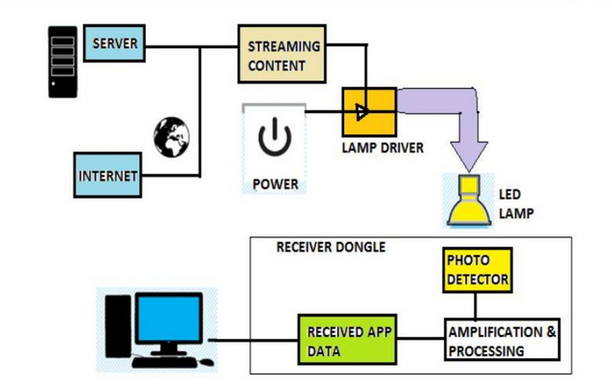
HOW LI-FI WORKS?

Slide 7
ON ONE END ALL THE DATA ON THE INTERNET WILL BE STREAMED TO A LAMP DRIVER WHEN THE ;ED IS TURNED ON THE MICROCHIP CONVERTS THE DIGITAL DATA IN THE FORM OF LIGHT
A LIGHT SENSITIVE DEVICE (PHOTO DETECTOR) RECEIVED THE SIGNAL AND CONVERTS IT BACK INTO ORIGINAL DATA. THIS METHOD OF USING RAPID PULSES OF LIGHT TO TRANSMIT INFORMATION WIRELESSLY IS TECHNICALLY REFERRED AS VISIBLE LIGHT COMMUNICATION

Slide 8
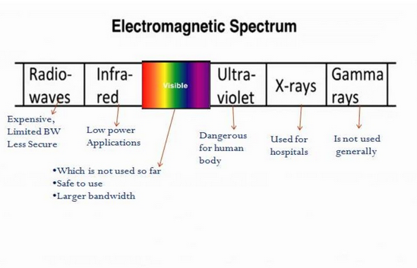
ELECTROMAGNETIC SPRECTRUM

Slide 9
WHY VLC
GAMA RAYS CANT BE USED AS THEY COULD BE DANGEROUS
X-RAY HAVE SIMILAR HEALTH ISSUES
ULTRAVIOLET LIGHT IS GOOD FOR PLACE WITHOUT PEOPLE, BUT OTHERWISE DANGEROUS FOR THE HUMAN BODY
INFRARED , DUE TO EEYE SAFETY REGULATION, CAN ONLY BSE USED WITH LOW POWER

Slide 10
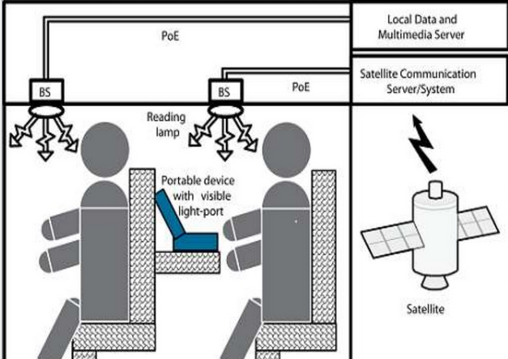

Slide 11
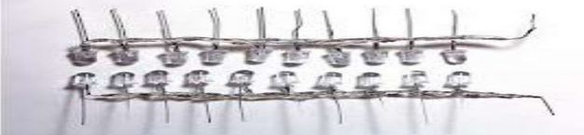
FURTHER ENHANCEMENTS CAN BE MADDE IN THIS METHOD , LIKE USING AN ARRAY OF LED’S FOR PARALLEL DATA TRANSMISSION, OR USING MIXTURES OF RED, GREEN AND BLUE LEDS TO ALTER THE LIGHT’S FREQUENCT WITH EACH FREQUENCY ENCODING A DIFFERENT DATA CHANNEL.SUCH ADVANCEMENTS PROMISE A THEORETICAL SPEED OF 10 Gbps – MEANING ONE CAN DOWNLOAD A FULL LENGTH HD FLIM IN JUST 30 SECONDS

Slide 12
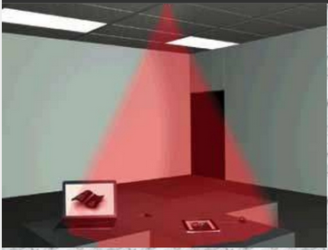
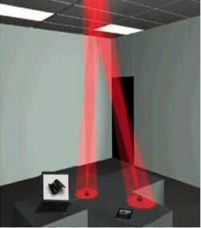
FOR GIGA SPEED TECHNOLOGIES, THE LIFI CONSORTIUM DEFINED GIGASHOWER, GIGASPOT AND GIGAMIMI MODELS.
GIGA SHOWER
GIGA MIMO

Slide 13
GIGASHOWER AND GIGAMIMO ARE THE OTHER MODELS FOR IN-HOUSE COMMUNICATION.THERE A TRANSMITTER OR RECEIVER IS MOUNTED INTO THE CEILING CONNECTED TO, FOR EXAMPLE, A MEDIA SERVER
GIGASHOWER PROVIDES UNIDIRECTIONAL DATA SERVICES VIA SEVERAL CHANNELS TO MULTIPLE USERS WITH GIGABITT-CLASS COMMUNICATION SPEED VOER SEVERAL METERS.IT IS LIKE WATCHING TV CHANNELS OR LISTENING TO DIFFERENT RADIO STATIONS WHERE TO UPLINK CHANNEL IS NEEDED. IN CASE GIGASHOWER IS USED TO SELL BOOKS, MUSIC, OR MOVIES, THE CONNECTED MEDIA SERVER CAN BE ACCESSED VIA Wi-Fi TO PROCESS PAYMENT VIA A MOOBILE DEVICE.GIGASPOT AND GIGAMIMO ARE OPTICAL WIRELESS SINGLE AND MULTI CHANNEL HOTSPOT CHANNELS OFFERING BIDIRECTIONAL GIGABIT CLASS COMMUNICATION IN A ROOM, HALL OR SHOPPING MALL FOR EXAMPLE.

Slide 14
LI-FI CONSTRUCTION
THE LI-FI PRODUCT CONSISTS OF 4 PRIMARY SUB-ASSSEMBLIES:-
BULB
RF POWER AMPLIFIER CIRCUIT(PA)
PRINTED CIRCUIT BOAED(PCB)
ENCLOSURE

Slide 15
THE PCB CONTROLS THE ELECTRICAL INPUTS AND OUTPUTS OF THE LAMP AND HOUSES THE MICROCONTROLLER USED TO MAMNAGE DIFFFERENT LAMP FUNCTIONS.
AN RF(RADIO-FREQUENCY) SIGNAL IS GENERATED BY THE SOLID-SATTE PA AND IS GUIDED INTO AN ELECTRIC FIELD ABOUT THE BLUB.THE HIGH CONCENTRATION OF ENERGY IN THE ELECTRIC FIELD VAPORIZES THE CONTENTS OF THE BULB TO A PLASMA STATE AT THHE BULD’S CANTER ; THIS CONTROLLED PLASMA GENERATES AN INTENSE SOURCE OF LIGHT. ALL OF THESE SUBASSEMBLIES ARE CONTAINED IN AN ALUMINIUM ENCLOEURE
IN BULB ASSEMBLY A SEALED BULB IS EMBDED IN A DIELECTRIC MATERIAL , IT IS USED AS AN ELECTRIC FIELD CONCENTRATOR THAT FOCUS ENERGY IN THE BULB.THE ENERGY FROM E.F RAPIDLY HEATS THE MATERIAL IN THE BULB TO A PLASMA STATE THAT EMITS LIGHT OF HOGH INTENSITY AND FULL SPRECTRUM

Slide 16
